Slide 1
THE CIRCULATORY SYSTEM

Slide 2
Name the three arm bones.
What three functions does the skeletal system have?
What does the M and the G stand for in MRS GREN?

Slide 3
Why do we have a heart?
How big is your heart?
List activities that would;
Increase heart rate
Decrease heart rate

Slide 4
Name, locate and know the function of parts of the circulatory system

Slide 5
Circulatory System
The system that circulates blood through the body, consisting of the heart, blood vessels, blood, lymph, and the lymphatic vessels and glands.

Slide 6
Heart
A hollow muscular organ that pumps the blood through the circulatory system

Slide 7
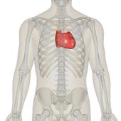
Name, locate and know the function of parts of the circulatory system
Why do you have two different sized lungs?
The heart is a powerful muscle that is situated between your lungs, protected by the ribcage
Heart: A hollow muscular organ that pumps the blood through the circulatory system
.

Slide 8
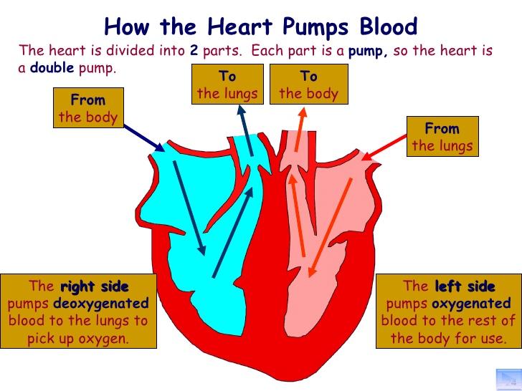
Name, locate and know the function of parts of the circulatory system
Where do we get the oxygen from?
The heart pumps blood to the lungs to get oxygen
Heart: A hollow muscular organ that pumps the blood through the circulatory system
.

Slide 9
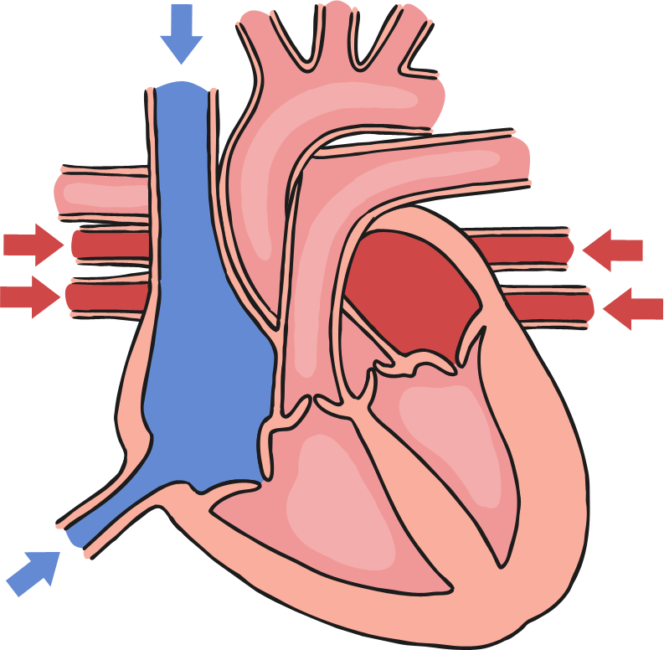
Name, locate and know the function of parts of the circulatory system
Where do we get the oxygen from?
Label your first heart in your book
aorta
aortic valve
pulmonary artery (left)
Heart: A hollow muscular organ that pumps the blood through the circulatory system
.
left pulmonary veins
right atrium
left atrium
left ventricle
right ventricle

Slide 10
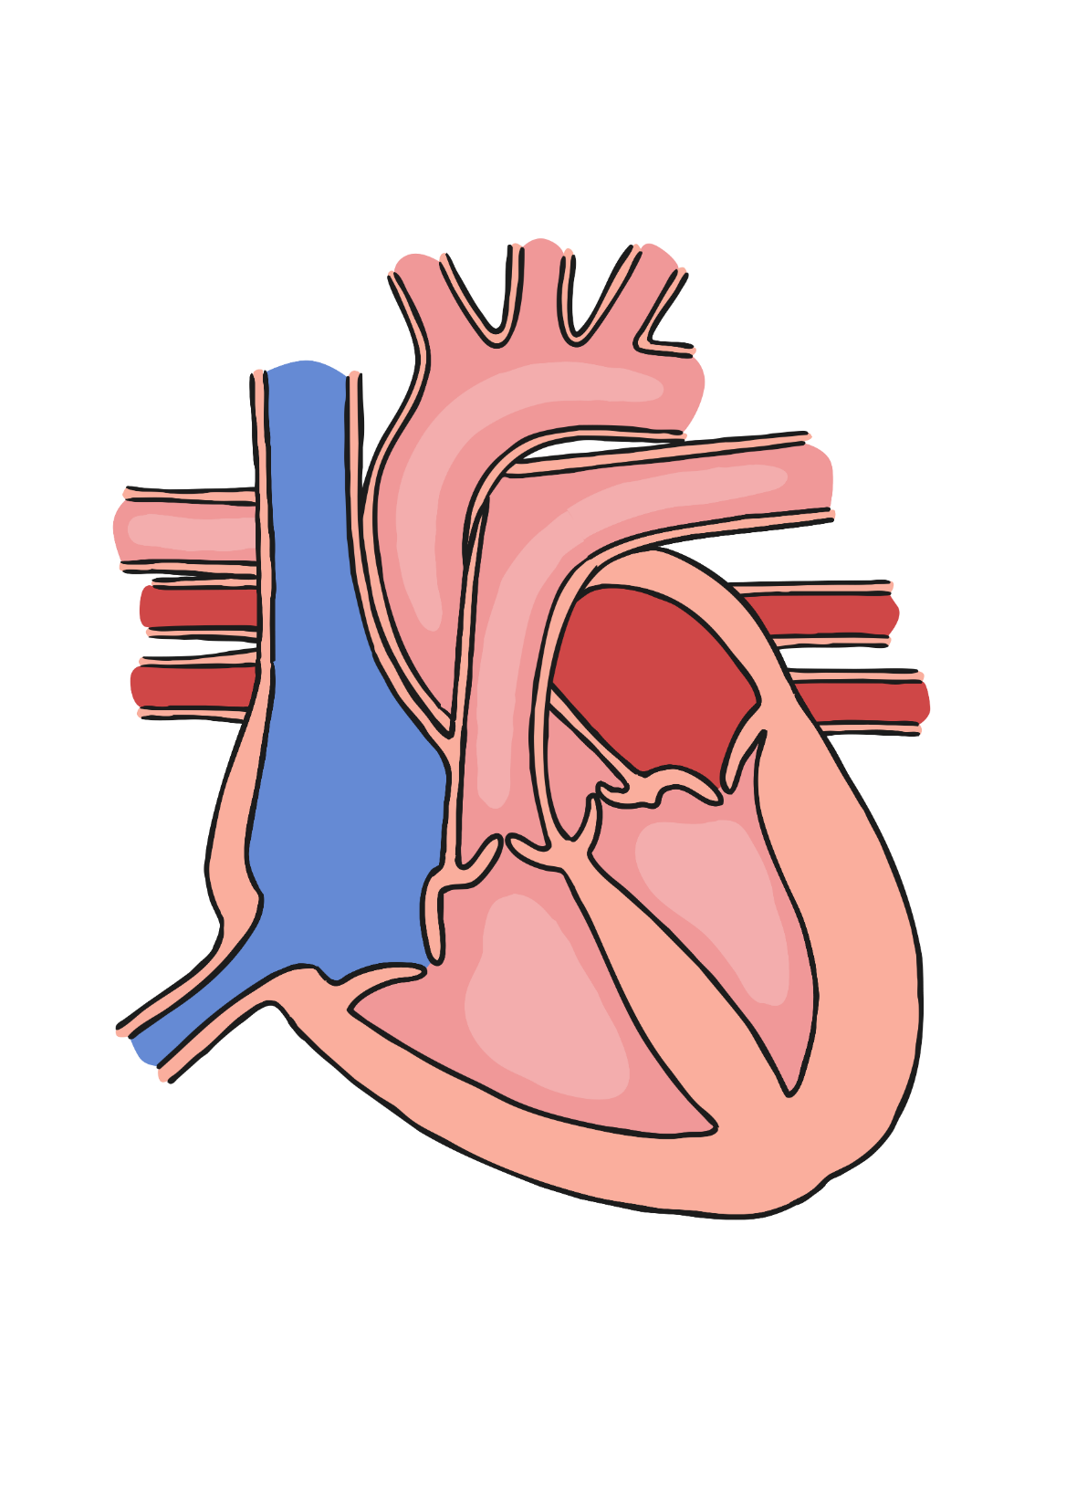
Name, locate and know the function of parts of the circulatory system
Click to go through each stage of the process.
Label your second heart in your book
right atrium
right ventricle
pulmonic valve
pulmonary artery (left)
left pulmonary veins
left atrium
left ventricle
aortic valve
aorta

Slide 11
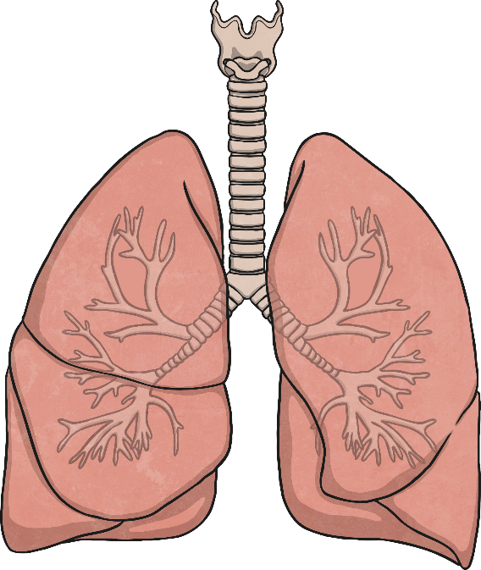
Name, locate and know the function of parts of the circulatory system
Where do we get the oxygen from?
The Function of the Lungs
review
When we breathe in (inhale), the intercostal muscles contract and the diaphragm pulls down, making the chest expand. This causes air to be sucked into the lungs.
The intercostal muscles and diaphragm then relax and the air is pushed out of the lungs (exhale) as the ribcage falls downward and inhale.
Heart: A hollow muscular organ that pumps the blood through the circulatory system
.
lung expands
lung shrinks
muscles contract
muscles relax
diaphragm pulls downwards
diaphragm relaxes

Slide 12
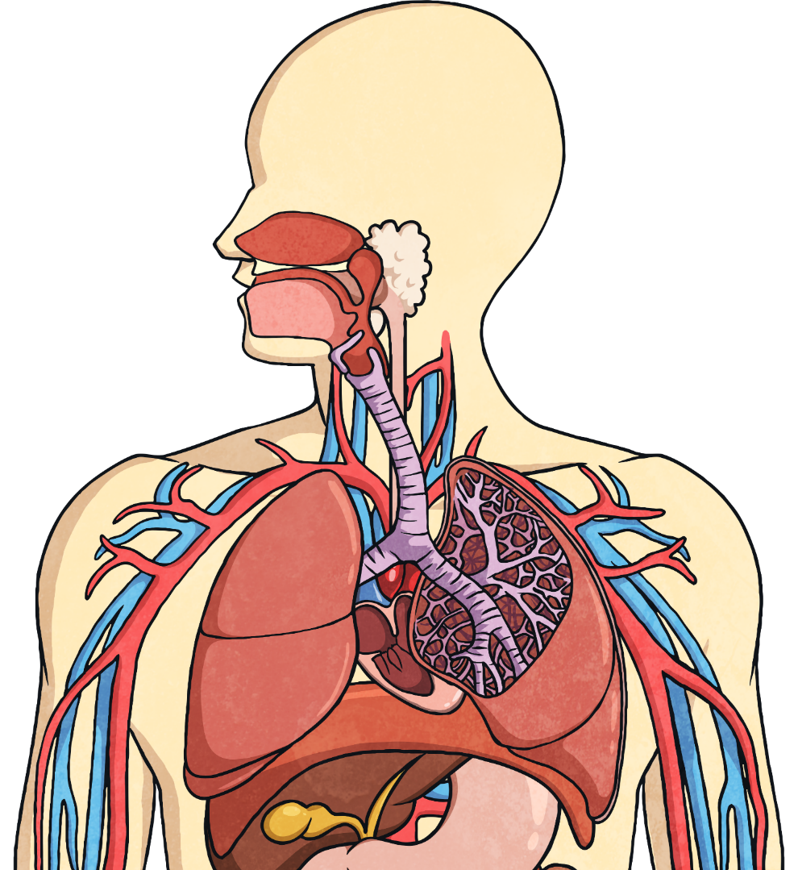
Name, locate and know the function of parts of the circulatory system
Where do we get the oxygen from?
The Function of the Lungs
review
Air breathed in through the mouth or nose travels down the trachea, through the bronchi into one of the lungs. The air travels into the bronchioles and into the air sacs (alveoli).
Heart: A hollow muscular organ that pumps the blood through the circulatory system
.
trachea
intercostal muscles and ribs
bronchus
bronchiole
heart
diaphragm
air sacs (alveoli)

Slide 13
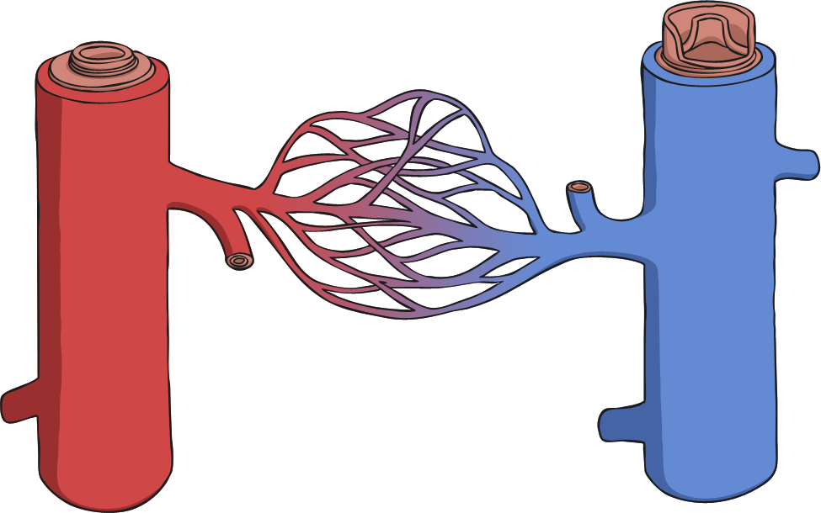
Name, locate and know the function of parts of the circulatory system
Where do we get the oxygen from?
What do blood vessels do?
Arteries – carries oxygenated blood away from the heart
Capillaries – enable exchange of oxygen with body
Veins – carries blood from capillaries back to the heart to be pumped to the lungs to be re-oxygenated.
Heart: A hollow muscular organ that pumps the blood through the circulatory system
.
capillaries
vein
artery

Slide 14
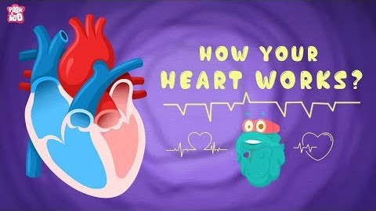
Name, locate and know the function of parts of the circulatory system
Use this video to fill the sheet out in the front of your book

Slide 15
Name, locate and know the function of parts of the circulatory system

Slide 16
Do Now –Add notes to your concertinaed body systems worksheet
 | Major Structures | Functions
Respiratory System | Air passages Lungs | Carries air into and out of the lungs, where gases are exchanged
Skeletal System | Bones | Provides structure, supports and protects internal organs
Integumentary | Skin, hair, nails | Protects against pathogens, helps regulate body temperature
Circulatory System | Heart, blood vessels, blood | Transports nutrients and wastes to and from all body tissues

